Slide 1
Dijkstra's algorithm

Slide 2
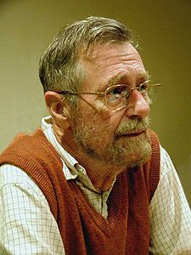
The author: Edsger Wybe Dijkstra
"Computer Science is no more about computers than astronomy is about telescopes."
http://www.cs.utexas.edu/~EWD/

Slide 3
Edsger Wybe Dijkstra
- May 11, 1930 – August 6, 2002
- Received the 1972 A. M. Turing Award, widely considered the most prestigious award in computer science.
- The Schlumberger Centennial Chair of Computer Sciences at The University of Texas at Austin from 1984 until 2000
- Made a strong case against use of the GOTO statement in programming languages and helped lead to its deprecation.
- Known for his many essays on programming.

Slide 4
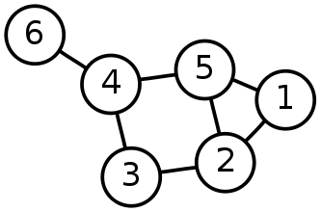
Single-Source Shortest Path Problem
Single-Source Shortest Path Problem - The problem of finding shortest paths from a source vertex v to all other vertices in the graph.

Slide 5
Dijkstra's algorithm
Dijkstra's algorithm - is a solution to the single-source shortest path problem in graph theory.
Works on both directed and undirected graphs. However, all edges must have nonnegative weights.
Approach: Greedy
Input: Weighted graph G={E,V} and source vertex v∈V, such that all edge weights are nonnegative
Output: Lengths of shortest paths (or the shortest paths themselves) from a given source vertex v∈V to all other vertices

Slide 6
Dijkstra's algorithm - Pseudocode
dist[s] ←0 (distance to source vertex is zero)
for all v ∈ V–{s}
do dist[v] ←∞ (set all other distances to infinity)
S←∅ (S, the set of visited vertices is initially empty)
Q←V (Q, the queue initially contains all vertices)
while Q ≠∅ (while the queue is not empty)
do u ← mindistance(Q,dist) (select the element of Q with the min. distance)
S←S∪{u} (add u to list of visited vertices)
for all v ∈ neighbors[u]
do if dist[v] > dist[u] + w(u, v) (if new shortest path found)
then dist[v] ←dist[u] + w(u, v) (set new value of shortest path)
(if desired, add traceback code)
return dist

Slide 7
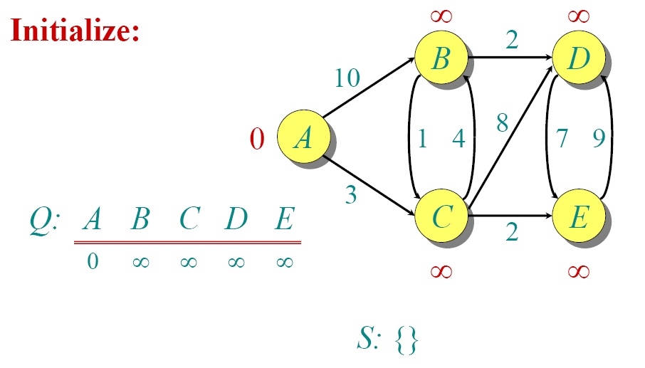
Dijkstra Animated Example

Slide 8
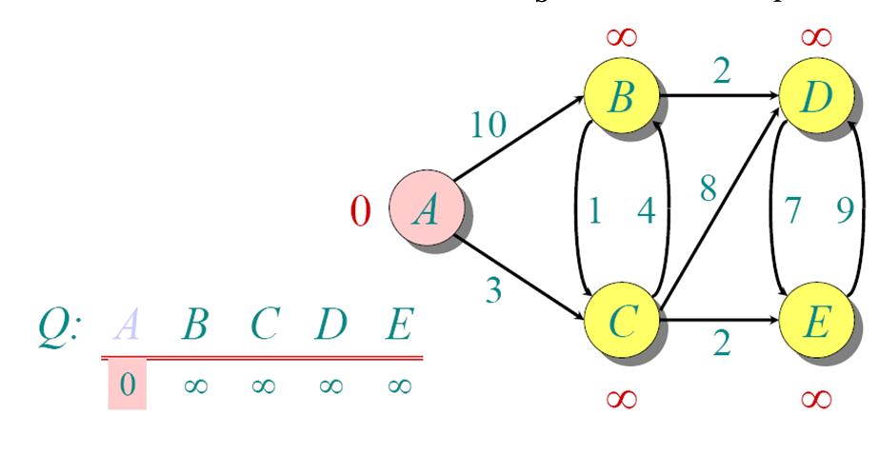
Dijkstra Animated Example

Slide 9
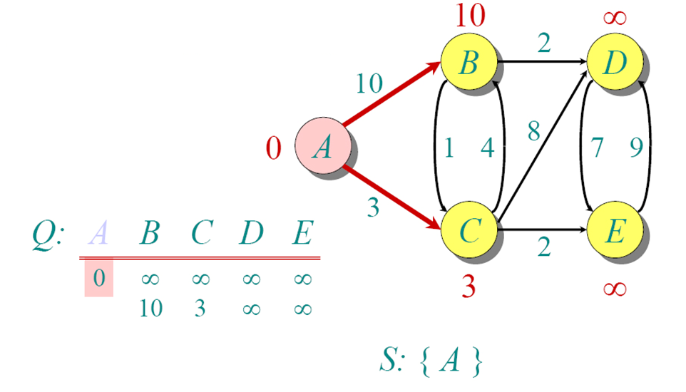
Dijkstra Animated Example

Slide 10
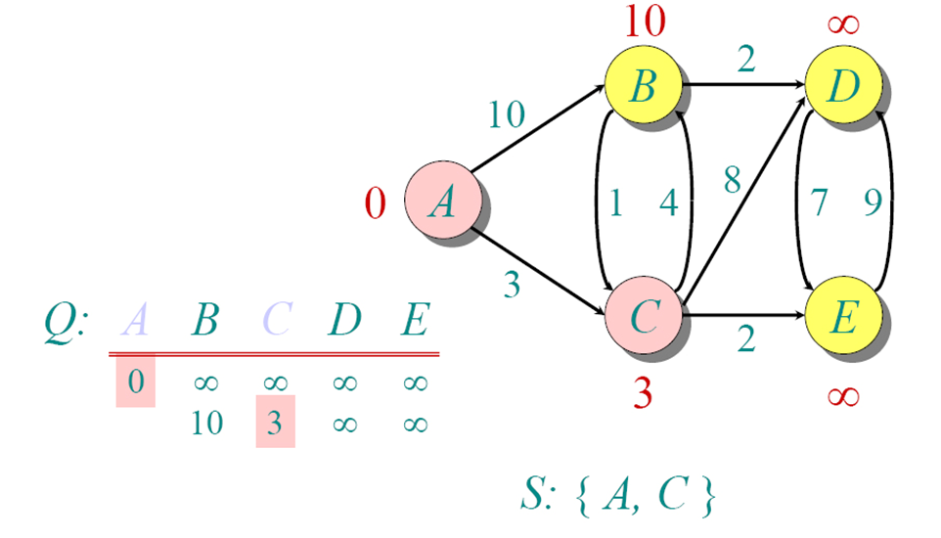
Dijkstra Animated Example

Slide 11
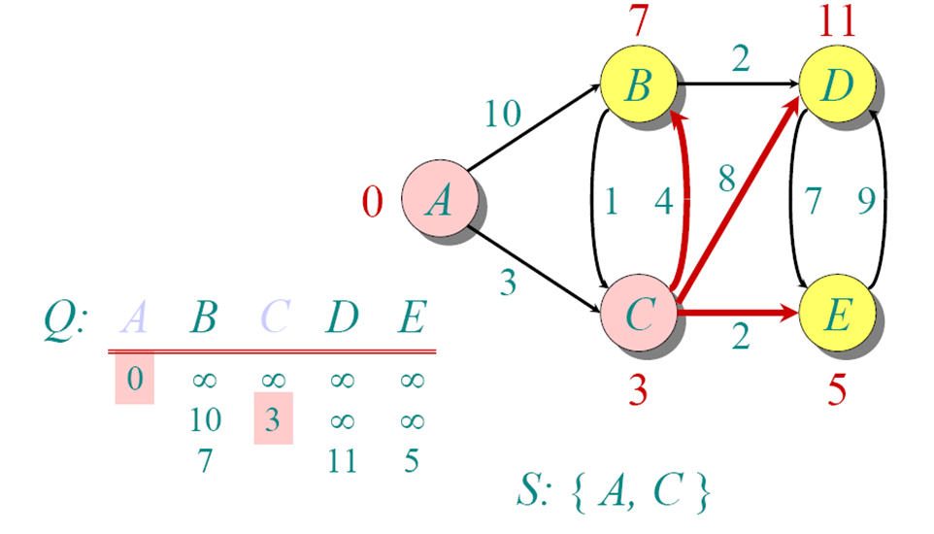
Dijkstra Animated Example

Slide 12
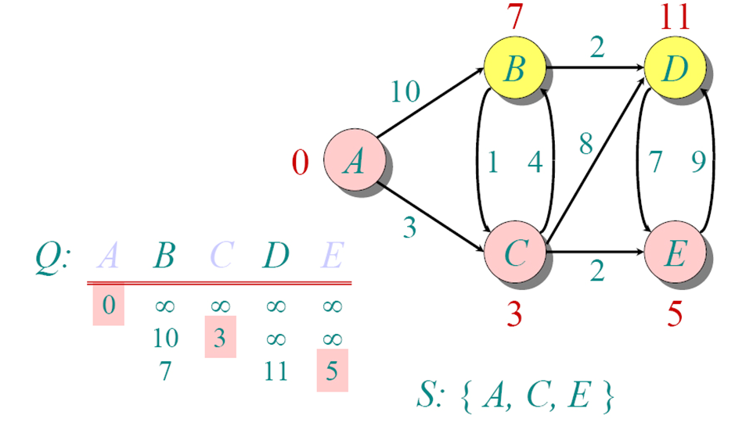
Dijkstra Animated Example

Slide 13
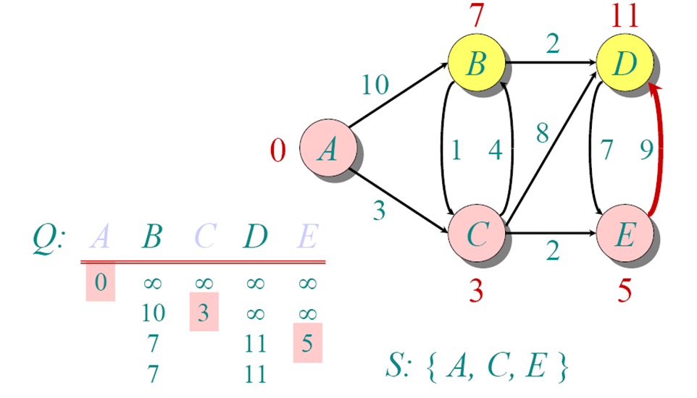
Dijkstra Animated Example

Slide 14
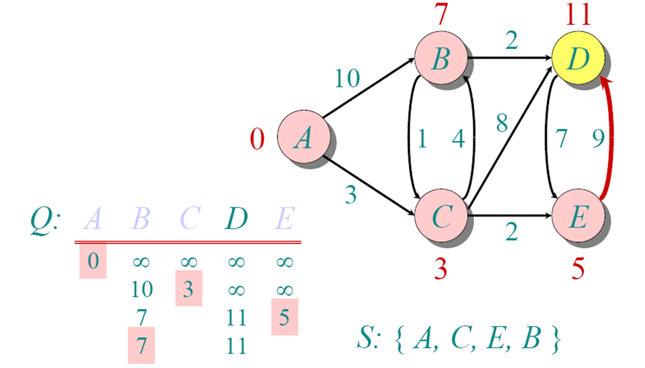
Dijkstra Animated Example

Slide 15
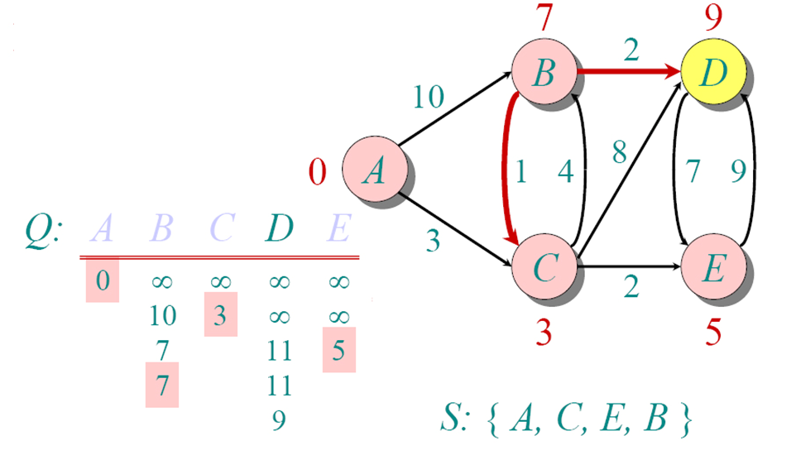
Dijkstra Animated Example

Slide 16
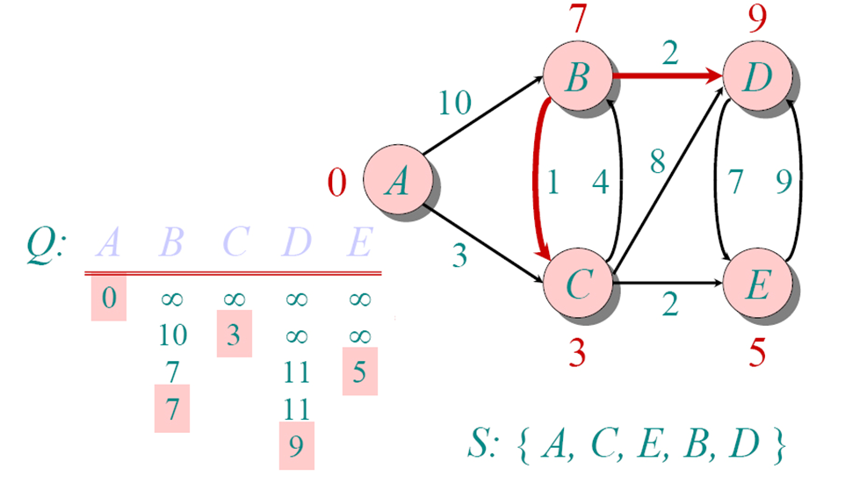
Dijkstra Animated Example

Slide 17
Implementations and Running Times
The simplest implementation is to store vertices in an array or linked list. This will produce a running time of
O(|V|^2 + |E|)
For sparse graphs, or graphs with very few edges and many nodes, it can be implemented more efficiently storing the graph in an adjacency list using a binary heap or priority queue. This will produce a running time of
O((|E|+|V|) log |V|)

Slide 18
Dijkstra's Algorithm - Why It Works
As with all greedy algorithms, we need to make sure that it is a correct algorithm (e.g., it always returns the right solution if it is given correct input).
A formal proof would take longer than this presentation, but we can understand how the argument works intuitively.

Slide 19
Dijkstra's Algorithm - Why It Works
To understand how it works, we’ll go over the previous example again. However, we need two mathematical results first:
Lemma 1: Triangle inequality If δ(u,v) is the shortest path length between u and v, δ(u,v) ≤ δ(u,x) + δ(x,v)
Lemma 2: The subpath of any shortest path is itself a shortest path.
The key is to understand why we can claim that anytime we put a new vertex in S, we can say that we already know the shortest path to it.
Now, back to the example…

Slide 20
Dijkstra's Algorithm - Why use it?
As mentioned, Dijkstra’s algorithm calculates the shortest path to every vertex.
However, it is about as computationally expensive to calculate the shortest path from vertex u to every vertex using Dijkstra’s as it is to calculate the shortest path to some particular vertex v.
Therefore, anytime we want to know the optimal path to some other vertex from a determined origin, we can use Dijkstra’s algorithm.

Slide 21
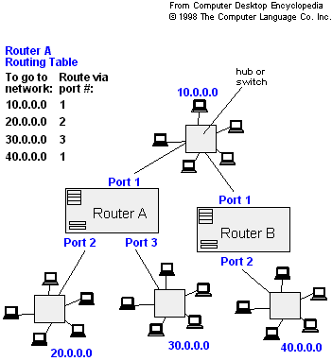
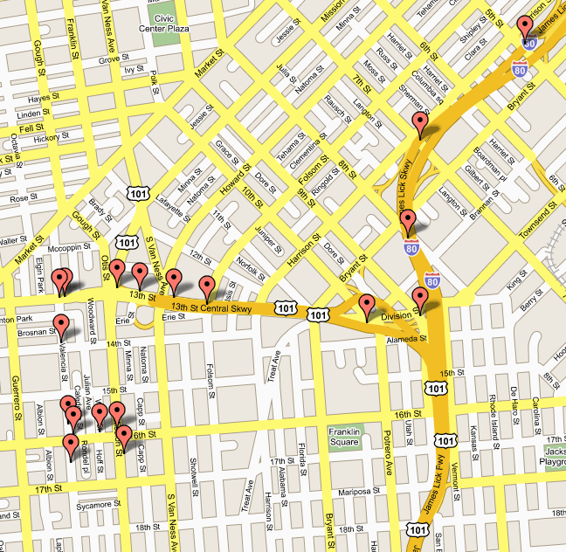
Applications of Dijkstra's Algorithm
- Traffic Information Systems are most prominent use
- Mapping (Map Quest, Google Maps)
- Routing Systems

Slide 22
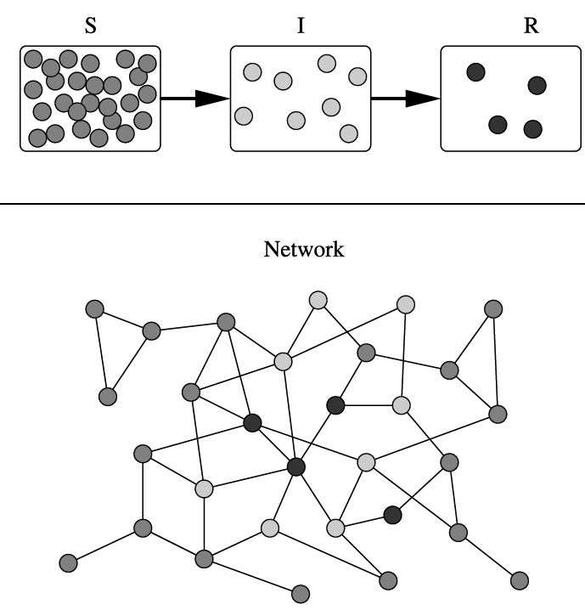
Applications of Dijkstra's Algorithm
One particularly relevant application: epidemiology
Prof. Lauren Meyers (Biology Dept.) uses networks to model the spread of infectious diseases and design prevention and response strategies.
Vertices represent individuals, and edges their possible contacts. It is useful to calculate how a particular individual is connected to others.
Knowing the shortest path lengths to other individuals can be a relevant indicator of the potential of a particular individual to infect others.

Slide 23
References
Dijkstra’s original paper: E. W. Dijkstra. (1959) A Note on Two Problems in Connection with Graphs. Numerische Mathematik, 1. 269-271.
MIT OpenCourseware, 6.046J Introduction to Algorithms. < http://ocw.mit.edu/OcwWeb/Electrical-Engineering-and-Computer-Science/6-046JFall-2005/CourseHome/> Accessed 4/25/09
Meyers, L.A. (2007) Contact network epidemiology: Bond percolation applied to infectious disease prediction and control. Bulletin of the American Mathematical Society 44: 63-86.
Department of Mathematics, University of Melbourne. Dijkstra’s Algorithm. <http://www.ms.unimelb.edu.au/~moshe/620-261/dijkstra/dijkstra.html > Accessed 4/25/09

